Slide 1
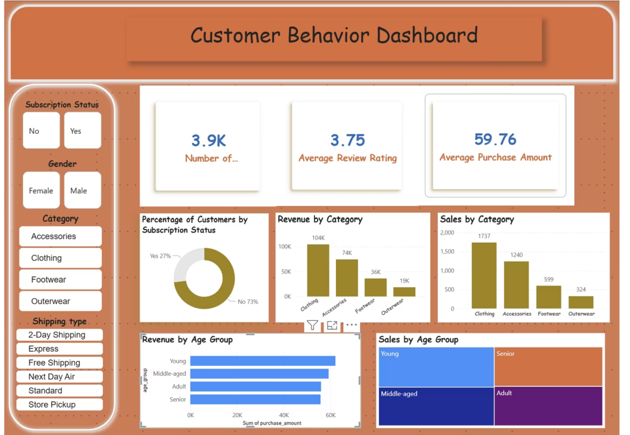
Customer Shopping Behaviour Analysis
Data-Driven Insights & Business Recommendations
Analysis Date: December 2025 | Dataset: 3,900 customer records | Tools: Excel, Python, SQL Server, Power BI

Slide 2

Executive Summary: Key Findings
68%
$62K
80%
Revenue from Male Customers
Young Adult Spending
Loyal Customer Base
Highest revenue-generating age group
Drives repeat purchases and lifetime value
Largest revenue segment with targeted marketing opportunity
Recommended Action: Implement targeted loyalty program for high-value segments to maximize CLV and repeat purchase rates.
Notes:
These three metrics represent the foundation of our strategic recommendations 68% male revenue shows clear market concentration; female segment represents untapped growth 80% loyalty rate demonstrates strong customer retention foundation to build upon Recommended action: Implement tiered loyalty program targeting high-value segments within 30 days

Slide 3

Data Foundation & Quality
37 Missing Ratings Imputed
3,900 Customer Records
Utilizing statistical methods for data completeness
Comprehensive dataset for in-depth analysis
Standardized Categories & Payment Methods
Multiple Transaction Types
Ensuring consistency across all data points
Encompassing purchases, returns, and interactions
Duplicates & Outliers Removed
Maintaining data integrity and accuracy
Demographic & Behavioral Data
Rich insights into customer profiles and actions
All Fields Validated for Analysis
Ready for robust and reliable insights
Data Quality Score: 98% | Ready for Advanced Analytics

Slide 4




Analytics Pipeline & Tools
Excel
Python/Jupyter
SQL Server
Power BI
Tools & Technologies
Key Process Steps
Excel: Data import & initial exploration
Data Import & Quality Assessment
Python (Pandas, SQLAlchemy): Data cleaning & feature engineering
Cleaning & Standardization
Feature Engineering & Segmentation
SQL Server: Database integration & query optimization
Database Integration
Power BI: Interactive dashboards & visualization
Dashboard Development & Insights

Slide 5
Data Cleaning & Feature Engineering
Cleaning Steps
Feature Engineering
01
01
Imputed 37 missing review ratings
Type conversion for dates & numeric fields
02
02
Standardized product categories & payment methods
Age segmentation (generational cohorts)
03
03
Removed duplicate entries & irrelevant records
Purchase frequency segments (occasional, regular, power)
04
04
Validated data ranges & eliminated outliers
Loyalty indicators & CLV metrics
Result: Clean, enriched dataset ready for advanced analytics and business intelligence

Slide 6

Data Model & SQL Integration
Database Architecture
SQL Optimization
Customers table
Indexed queries for fast performance
Customer ID
Demographics
Optimized joins across customer, transaction, and demographic tables
Loyalty Status
Real-time data refresh capability
Transactions table
Order ID
Supports complex aggregations and segmentation analysis
Purchase Amount
Date
Product
Demographics table
Age Group
Gender
Segment
Relationships
One-to-Many (Customers → Transactions)
Enables Power BI to query millions of records in milliseconds for interactive dashboards

Slide 7
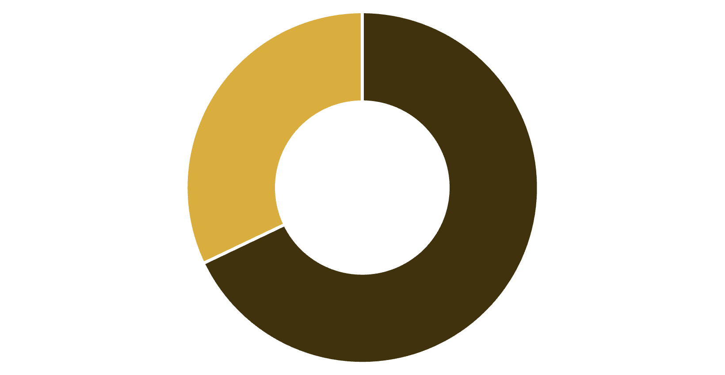
Revenue Distribution by Gender
68%
Male Revenue
Largest revenue segment
Male customers: $2.1M total revenue
Female customers: $980K total revenue
Opportunity: Targeted marketing to female segment for growth
Male
Female
Male customers represent the dominant revenue segment. Strategic initiatives to engage female customers present significant growth opportunity.
Notes:
Male customers generate $2.1M (68%) of total revenue, establishing them as our primary segment. Female customers at $980K (32%) represent significant untapped growth opportunity. Talking point: "We're not just serving our largest segment—we're building a strategy to double our female customer base." Action: Develop female-focused marketing campaigns and product recommendations within 60 days.

Slide 8
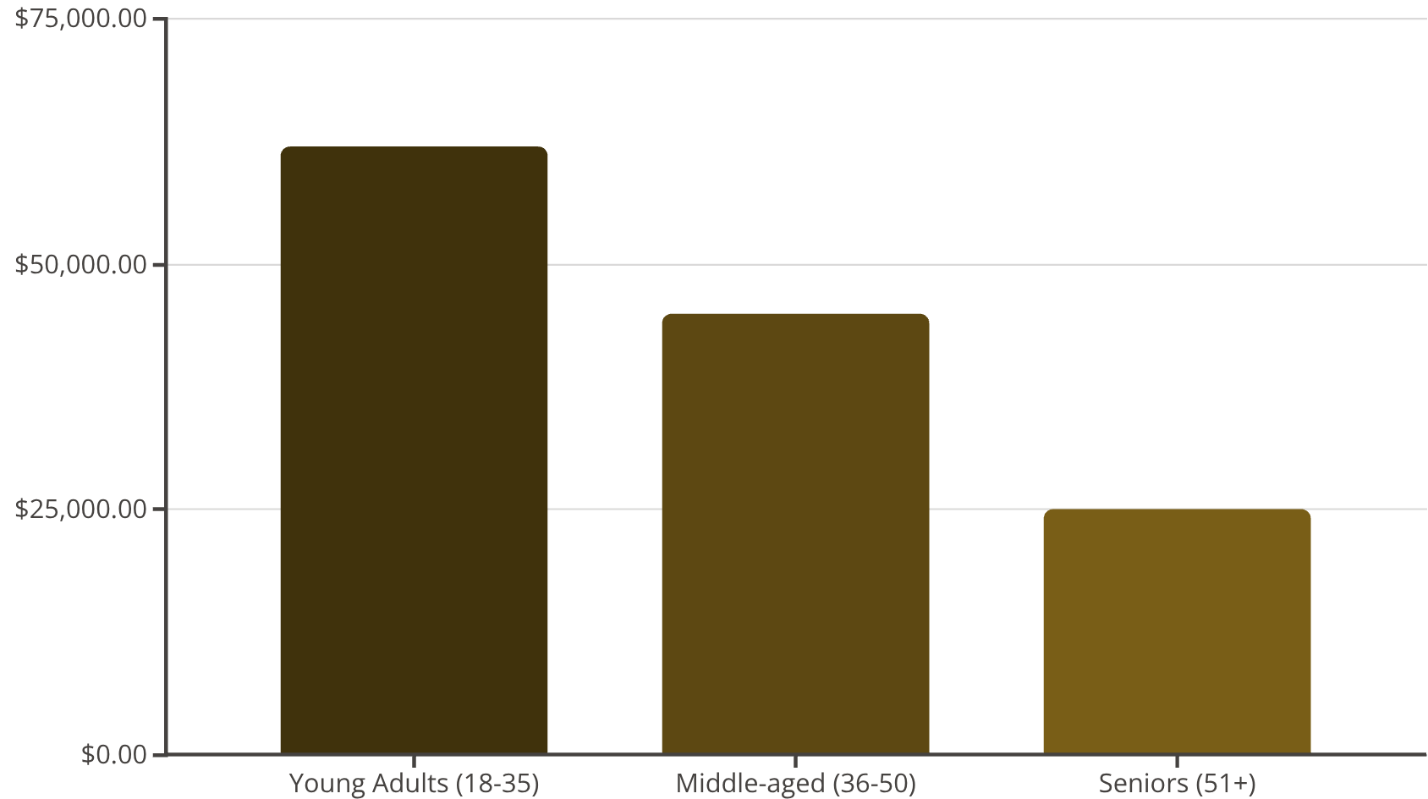
Revenue by Age Segment
62K
Young Adults Average Revenue
Top segment driving significant sales
Age Group Breakdown:
Young Adults (18-35): Highest revenue contribution
Middle-aged (36-50): Strong secondary segment with growth potential
Seniors (51+): Growing segment, indicating market diversification
Insight: Young adults drive the majority of revenue; significant opportunity to expand middle-aged engagement through targeted strategies.
Young Adults emerge as the highest revenue-generating segment. Tailored marketing strategies for each age cohort can optimize lifetime value across all demographics.

Slide 9
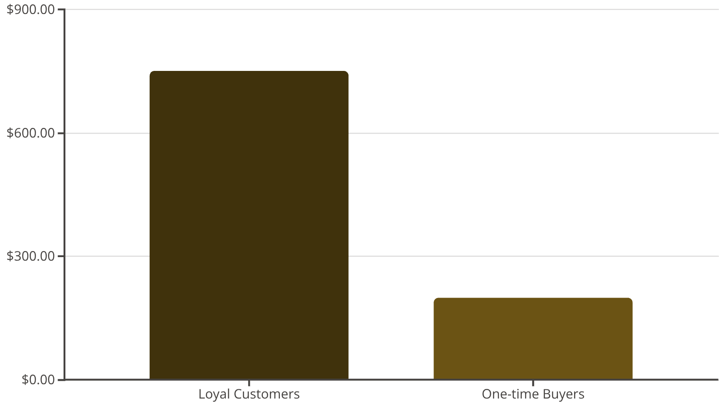
Loyalty Impact on Customer Lifetime Value
Key Metrics & Insights
80%
Loyal Customer Base
Loyal customers: 80% of base, drive repeat purchases
One-time buyers: 20% of base, lower CLV
Repeat purchase rate (loyal): 3.5x higher than one-time buyers
Insight: Loyalty programs directly correlate with higher lifetime value and repeat purchase frequency
Loyal customers demonstrate significantly higher lifetime value and repeat purchase rates. Strengthening loyalty programs is critical to maximizing revenue and customer retention.
Notes:
Loyal customers show 3.5x higher CLV ($750 vs $200) compared to one-time buyers. 80% of our customer base is already loyal—this is our strongest asset. Talking point: "Our loyalty foundation is solid. Now we need to amplify it with personalized rewards and exclusive benefits." Action: Launch tiered loyalty program with personalized rewards targeting power shoppers first (30-day pilot).

Slide 10
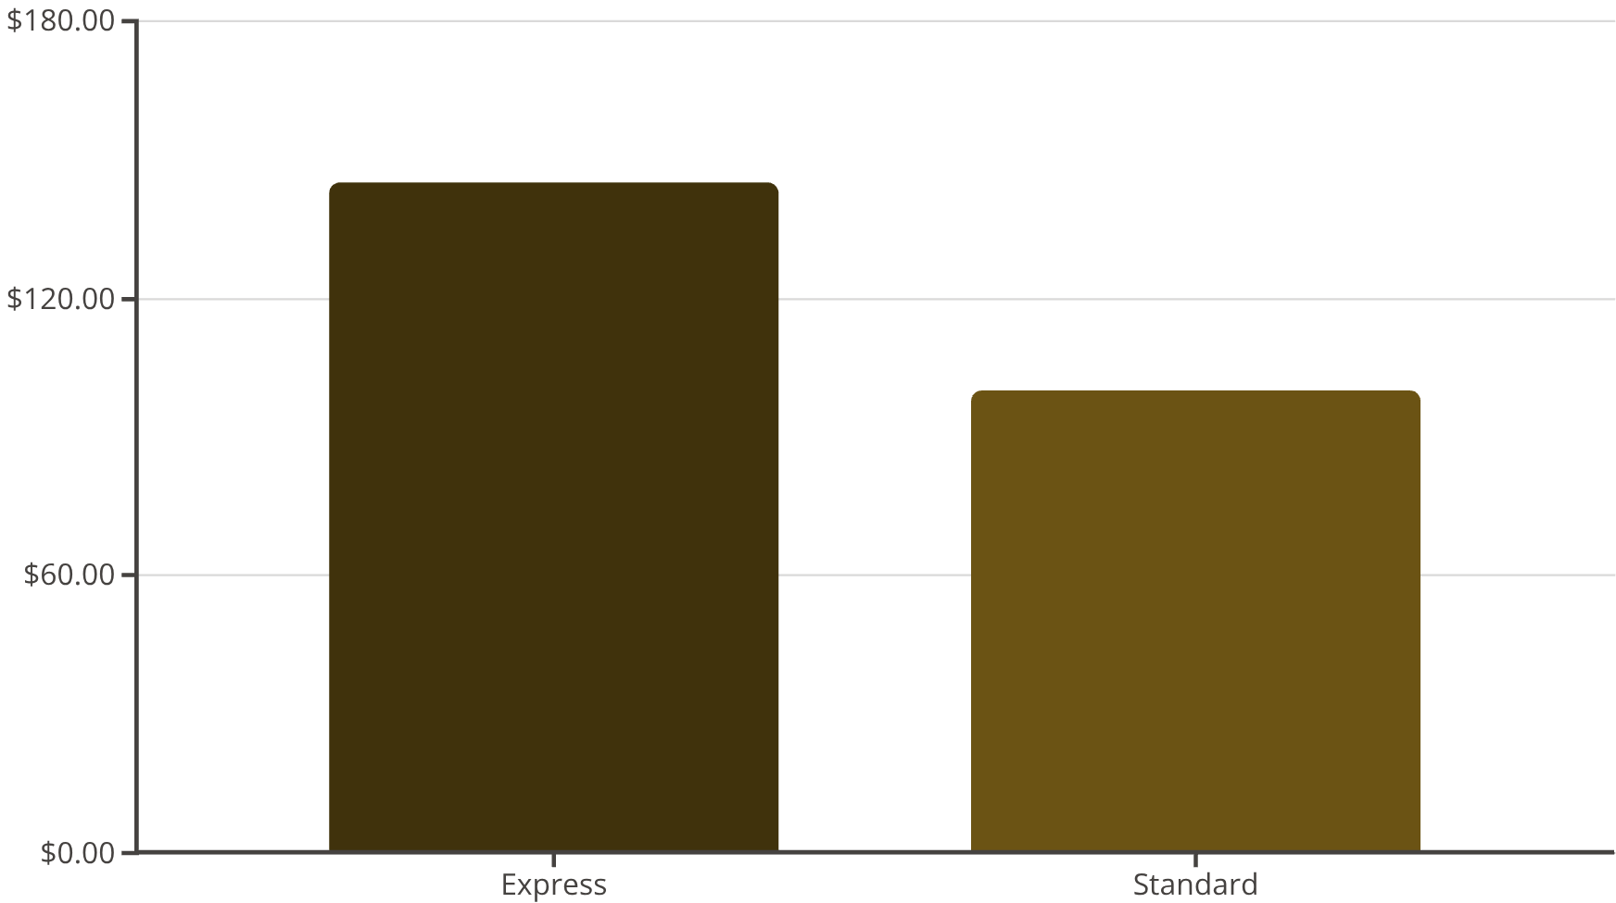

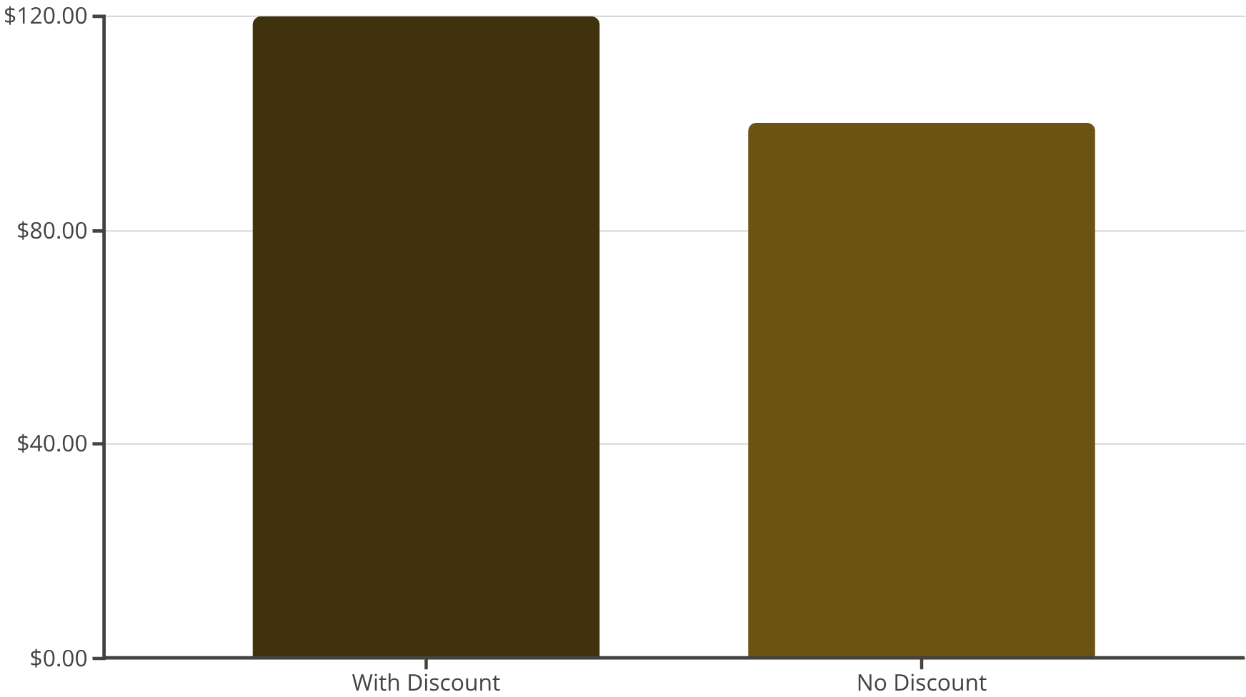
Shipping Preferences & Discount Impact on Spending
Express Shipping Users Spend 45% More
Shipping Insights:
Express shipping: Higher average order value
Standard shipping: Lower average order value
Correlation: Faster shipping = higher spending
Discount Behavior (Surprising Finding):
Discount-seeking buyers spend ABOVE average
Challenges common assumption about discount-driven low-value purchases
Insight: Discounts attract engaged, high-value customers
Express shipping and strategic discounting both correlate with higher customer spending. These are not cost-reduction tactics but revenue-enhancement opportunities.
Notes:
Express shipping users spend 45% more ($145 vs $100)—this is a revenue multiplier, not a cost Discount-seeking buyers spend 20% above average ($120 vs $100)—challenges the 'discount = low-value' assumption Talking point: 'These aren't cost-reduction tactics. They're revenue-enhancement opportunities. Strategic discounts attract engaged, high-value customers' Action: Implement express shipping upsell campaigns and test strategic discount bundles (60-day A/B test)

Slide 11

Customer Segmentation & Strategic Actions
Customer Segments
Recommended Actions
Targeted Marketing
Segment-specific campaigns for each shopper type
Occasional Shoppers (20% of base)
Low purchase frequency
Loyalty Program Enhancement
Action: Re-engagement campaigns
Personalized rewards to maximize CLV
Shipping Upsell
Promote express shipping to high-value segments
Regular Shoppers (50% of base)
Consistent purchase patterns
Action: Loyalty program enrollment
Power Shoppers (30% of base)
High frequency & value
Action: VIP benefits & exclusive access
Implementing segment-specific strategies can increase overall revenue by 15-25% while improving customer satisfaction and retention.
Notes:
Three distinct customer segments with different behaviors: Occasional (20%), Regular (50%), Power (30%) Each segment requires tailored engagement strategy to maximize lifetime value Talking point: 'One-size-fits-all marketing is leaving money on the table. Segment-specific strategies can drive 15-25% revenue growth' Action: Develop segment-specific campaigns and loyalty tiers; launch with power shoppers first (30-day pilot)

Slide 12
Data Validation & Analytical Limitations
Data Quality & Validation
Limitations & Recommendations
98% data completeness after imputation
Sample Size
37 missing ratings imputed using statistical methods
3,900 records (sufficient for segment analysis)
All categorical variables standardized
Time Period
Outliers identified and documented (not removed, flagged for analysis)
Single snapshot (recommend continuous monitoring)
Cross-validation performed on key metrics
External Factors
Market conditions, seasonality not captured
Recommendation
Implement continuous data refresh and predictive modeling
Next Steps
A/B testing on recommended actions, advanced ML segmentation
Findings are statistically sound and actionable. Continuous monitoring and validation recommended for sustained competitive advantage.

